Slide 1
APPLICATIONS OF BIOTECHNOLOGY
Chapter 21(old) & 23(new)
3AB HUMAN BIOLOGY

Slide 2
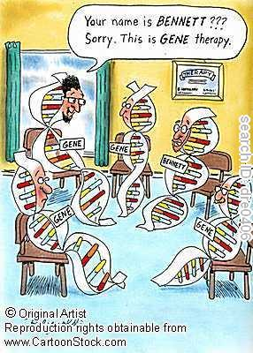
GENE THERAPY
Aims to treat or cure gene abnormalities by replacing faulty genes with healthy ones.
Currently only used in single gene disorders e.g. Huntington’s disease, cystic fibrosis, muscular dystrophy and sickle cell anaemia.

Slide 3
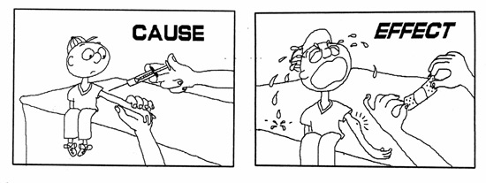
CYSTIC FIBROSIS
CAUSE
EFFECT
Mucous glands secrete thick, sticky mucous
In Lungs: Mucous obstructs airways and traps bacteria. This can lead to infection.
Repeated infection leads to irreversible lung damage and short life expectancy.
Pancreas: Prevent secretion of digestive enzymes.
Caused by mutation in Cystic fibrosis transmembrane regulator gene (CFTR)
Inheritance occurs when receive recessive allele from both parents
CFTR gene makes a protein that controls movement of salt and H₂O in cells

Slide 4
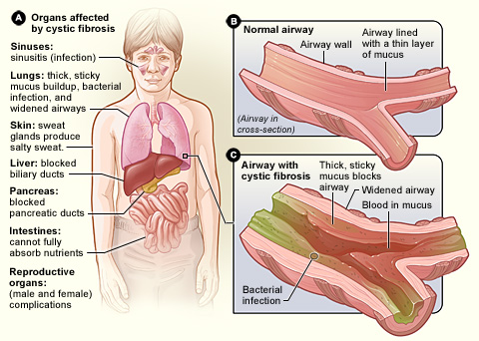

Slide 5
Gene Therapy & CF
Why it can be treated with gene therapy?
All babies undergo blood test 3 days after birth.
Single gene disorder.
Lungs easy to access.
Is a slow progressing disease, therefore can start therapy before significant damage to lungs occurs. (Use as a preventative treatment)

Slide 6
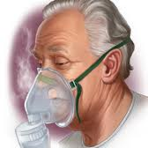
GENE DELIVERY
Using vector (e.g. use a cold virus) to carry healthy CFTR gene to cells in lungs
Nose drops.
Drizzling synthetic vectors down a flexible tube to CFTR cells.
Experimenting with nebulisers.

Slide 7
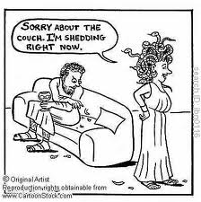
Lasting effect of delivery to body?
Epithelial cells of airways die and are replaced every 120 days, resulting in expression of CFTR gene in cells short lived. Treatment may have to be given 3-4 times year for continued expression.

Slide 8
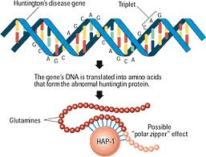
HUNTINGTON’S DISEASE
CAUSE
EFFECT
Mutation of a single gene (IT15 located on chromosome 4) resulted in mutated form of Huntington protein.
Mutation causes repetition of the DNA sequence causing the disease being inserted into the gene.
Huntington protein is essential for healthy nerve cells.
Symptoms only appear after 40 years of age.
Mutation cause damage of nerve cells in brain.
Physical, mental and emotional retardation.
Progressive dementia, can’t think clearly.

Slide 9
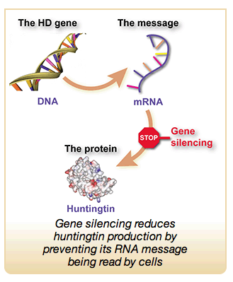
GENE THERAPY
INITIAL OPTION: Silencing or shutting off the gene that codes for Huntington protein.
Problem: brain cannot function without this protein.
CURRENT OPTION: Current research on rats and primates:
Delivery of modified virus vector with a corrective gene into brain cells has provided a natural shield against effects of defective gene

Slide 10
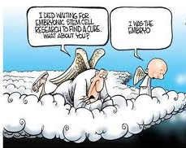
Characteristics of stem cells
Initially unspecialised; not assigned to any specific task
Can repeatedly divide and replicate themselves via mitosis.
Can differentiate into specialised cells given the right conditions.

Slide 11
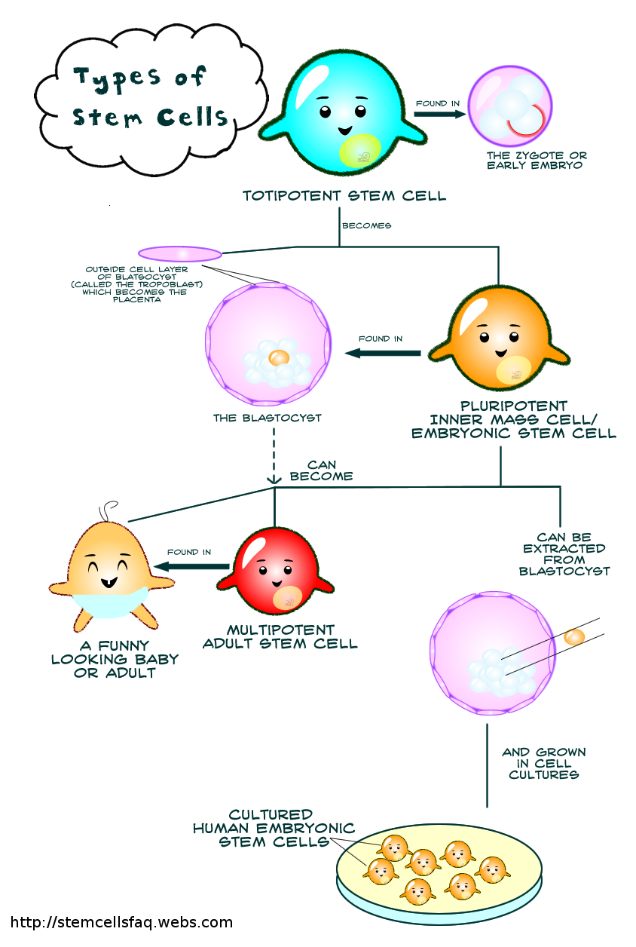
Embryonic Stem Cells
Taken from Inner cell mass of 4-5 day old embryo (blastocyst).
2 Types of stem cells:
Pluripotent: as able to differentiate into any cell type that makes up the human body (ALL tissues and organ) But not embryonic membrane
Totipotent: able to differentiate into any type of cell that makes up human body or membranes that surround the developing embryo.

Slide 12
Adult Stem Cells
Multipotent stem cells: are pre-programmed to differentiate into only certain types of cells.
E.g. stem cells from bone marrow can give rise to any type of blood cell but can’t produce any other type.

Slide 13
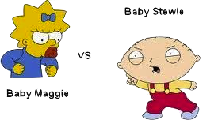

Ethical concerns of Stem cells
Conflict of human values has been a major issue for this research
AGAINST
Obtaining stem cells requires death of embryo…
Embryo marks the start of life with the potential to develop into a mature human being.
FOR
Use of embryonic stem cells can alleviate human suffering.

Slide 14
CELL REPLACEMENT THERAPY
Can be used in any disorder that involve the loss or damage to normal cells.
Especially useful in replacing degenerating nerve cells in conditions such as Parkinson's and Alzheimer’s disease

Slide 15
NEURAL CREST CELLS
Sourced from hair follicles.
Similar to embryonic stem cells. Can differentiate into many diverse cell types.
Can use patients own neural crest cells, eliminate rejection of implanted material and use of embryos.
Research still in animal testing phase.

Slide 16
TISSUE ENGINEERING
To restore healthy tissues or organs, eliminate need for organ transplants.
Requirements:
Abundant supply of diseased free cells.
Natural e.g. Collagen or fibrin or artificial material polylactic acid (scaffold) that cells can grow on. It must have high pore size to allow growth and allow materials for nutrition to diffuse into cells to make a 3D structure.
Scaffold needs to be biodegradable.

Slide 17
Cell-covered scaffold implanted into patient at site where new tissue is required
Cells continue to grow and scaffold breaks down or gets absorbed by body.
Technique used for developing tissues e.g. Bone, skin cartilage and adipose tissue

Slide 18
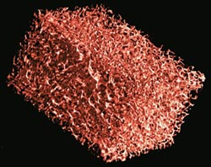

Slide 19
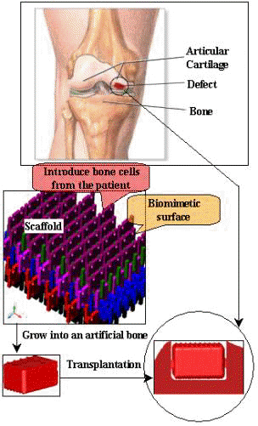

Slide 20
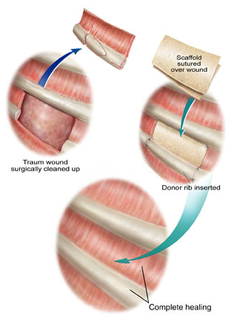

Slide 21
